Slide 1

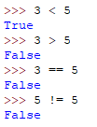


Common mistake: Incorrect formulation of Boolean expressions
In the following slides, we will look at examples of both valid and invalid Boolean expressions. This will help to ensure that we construct logically sound conditions for if and while statements.
Lets begin with some simple Boolean expressions, as entered directly into the interpreter:
Notice that in each of these expressions, the result is always either True or False.
This is the key characteristic of Boolean expressions.
Boolean expressions can be combined with the two Boolean operators: ‘and’, ‘or’.
When combined correctly in this way, the resulting expression is also a Boolean expression: that is, it will resolve down to True or False.
or equivalently…
Click to continue…

Slide 2
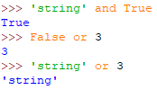

Common mistake: Incorrect formulation of Boolean expressions
Now, lets look at what doesn’t work:
On either side of a Boolean Operator (and, or) there should only be Boolean Expressions (something which resolves down to True or False)
If anything but a Boolean Expression is used in conjunction with a Boolean Operator, the result could be undesirable, as in each of the cases shown to the left.
Here’s an example of an if statement constructed the wrong way. (This is a common mistake with novice programmers)
This needs to be a Boolean expression too!!
Boolean expression
Boolean operator
Integer
Putting something other than a Boolean expression on either side of a Boolean operator is like trying to evaluate the expression 1 + 🍕 . It makes no sense.
Click to continue…

Slide 3
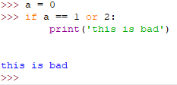

Common mistake: Incorrect formulation of Boolean expressions
This is a serious issue, however. The previous if statement will actually execute without any syntax error or exception being thrown by the interpreter. You can check this for yourself:
Because it still compiles and executes, this kind of mistake can produce erroneous results, and can be quite difficult to debug.
Here is the result of the same code being executed again, but with a correctly formulated Boolean expression on the right hand side.
Moral of the story:
When constructing your if and while statements, make sure that you are using Boolean expressions on either side of your Boolean operators.
Click to continue…

